Slide 1
Fake News Detection: Low Resource
Paper Title: Ban Fake News → A Dataset for Detecting Fake News in Bangla

Slide 2
Motivation
Fake News is published with the intent to damage the reputation of an Agency, entity or a person.
Hostile government actors are paid to propagate fake news.
2016 US Elections, more than 25% of Americans visited a fake news website during the six-week election period.
In 2012 in Bangladesh, just due to one fake FB post that made fun of a religion, 25k protestors destroyed 12 Buddhists temples and burned 50 homes.
Fact checking websites take very slow to respond.
No data exists for Bangla FND.
Bangla is 6th most spoken language in the world.

Slide 3
Author’s Contributions
Created and publicly released 50k annotated Bangla News Dataset
Create a benchmark for FND in Bangla
Compare results with human performance

Slide 4
Dataset Description
For annotating:
Real: Top 22 Bengali News channels
Fake: Any news article that falls under the below three categories
Misleading / False Context
Clickbait
Satire / Parody

Slide 5
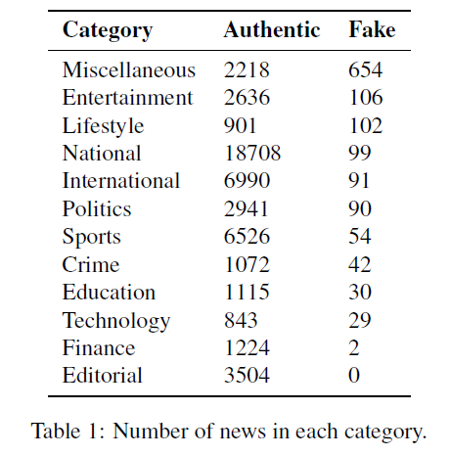
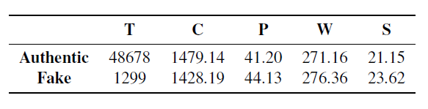
Dataset Distribution
Dataset is highly unbalanced:
# Real / Authentic Samples: ~48.6k
# Fake Samples: ~1.2k

Slide 6
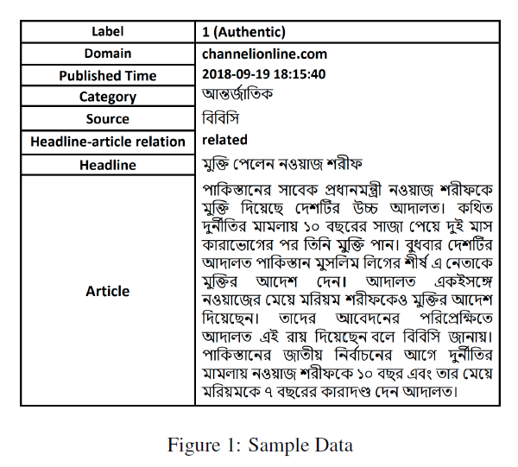
Sample Datapoint

Slide 7
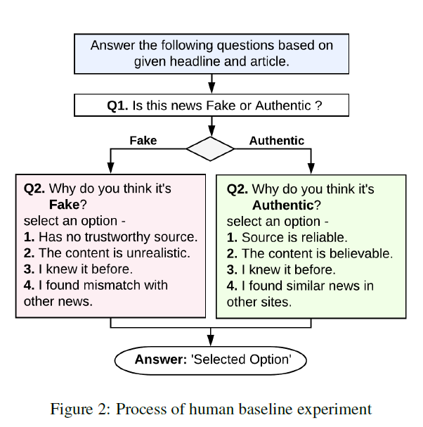
Human Base Line
5 annotators
150 News Articles: (60 Fake)
For every news answer 2 questions
Results:
F1-Score of Fake Class: 58%, 65%, 70%, 68%, 63%
Fleiss’ Kappa: 38.33%
80% of the times option 1 and 2 are the reasons for the label in case of both fake and authentic
Reasons: Disguise, Trending, Source, Satire
E.g. Hydroxychloroquine as Covid Vaccine

Slide 8
Features Used
Lexical Features:
Word n-grams (n = 1,2,3)
Character n-grams (n = 3,4,5)
TF-IDF for weighing
Syntactic Features: Normalized frequency of different POS tags to create a feature set
Semantic Features:
300 dimension Fast text word embeddings for Bangla
100 dimension custom Word2Vec word embeddings from 20k Bangla News Corpus
Used mean and standard deviation of these embeddings to represent an article
Punctuation marks frequency: For example ‘!’ have a high frequency in fake news
Length of headline and the body

Slide 9
Models Used
SVM
Random Forest
Logistic Regression
Neural Network based models:
CNN
Bi-LSTM with attention
BERT

Slide 10
Experimental Setup
Data Pre-processing: Basic text pre-processing along with Bangla stopwords removal
Evaluation Metric: Micro-F1 Score
Baselines:
Majority: Every sample is given majority label
Random: Randomly label samples as authentic or fake

Slide 11
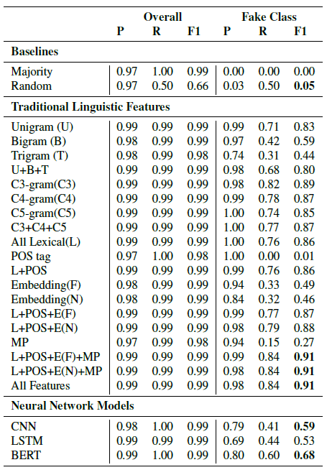
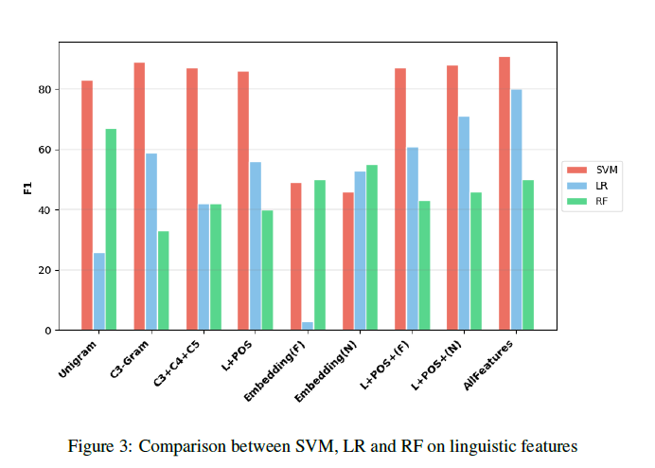
Results

Slide 12
Conclusion
Linear classifiers with traditional linguistic features perform better than neural network models
Character-level features are more significant than word-level features
Use of punctuation in fake news is more often then in real news
SVM based models and BERT based model outperformed human performance

Slide 13
Thank You

